Slide 1

Ancient Egyptian Society
Year 7 HASS – History: Ancient Egypt

Slide 2
Learning Intention & Success Criteria
Write these onto your worksheet.
LI:
Describe the way in which ancient Egyptian society was structured into different social classes and the roles of each group.
SC:
Define the term ‘hierarchy’ and correctly identify where groups in Egyptian society were placed on the hierarchy.
Outline the role of each group in society.
Identify which group you would have liked to belong to and explain why.

Slide 3
Egyptian Society: Structure
Use the information on the slide below to fill the gaps on your worksheet.
Egyptian society was structured like a pyramid. The few at the top of society had power and influence. There were many people at the bottom who had no power and influence and were ruled by those above them.
The way people lived also depended on their position in society.
Those at the top were rich, powerful and influential. They owned houses and land, and controlled a lot of people.
Those at the lower end were usually poor and worked hard for the people above them.

Slide 4
Status
A person’s place in society was determined by their family background, age and gender. Men usually did the jobs that their fathers did.
Your social status was fixed. Usually people did not move from lower to higher class. On very rare occasions, people might move to a higher class if they had lots of skills, gained an education or if they married someone of a higher class.
QUESTION: Where on the pyramid would you have liked to sit in Ancient Egypt? Why?

Slide 5
Activities
Add the following word and definition to the glossary in your HASS book:
  Hierarchy: a system where members of society are ranked according to their level of status or authority.
If Narrogin SHS was to be structured as a hierarchy, how would it look? Draw onto the pyramid on your worksheet.

Slide 6
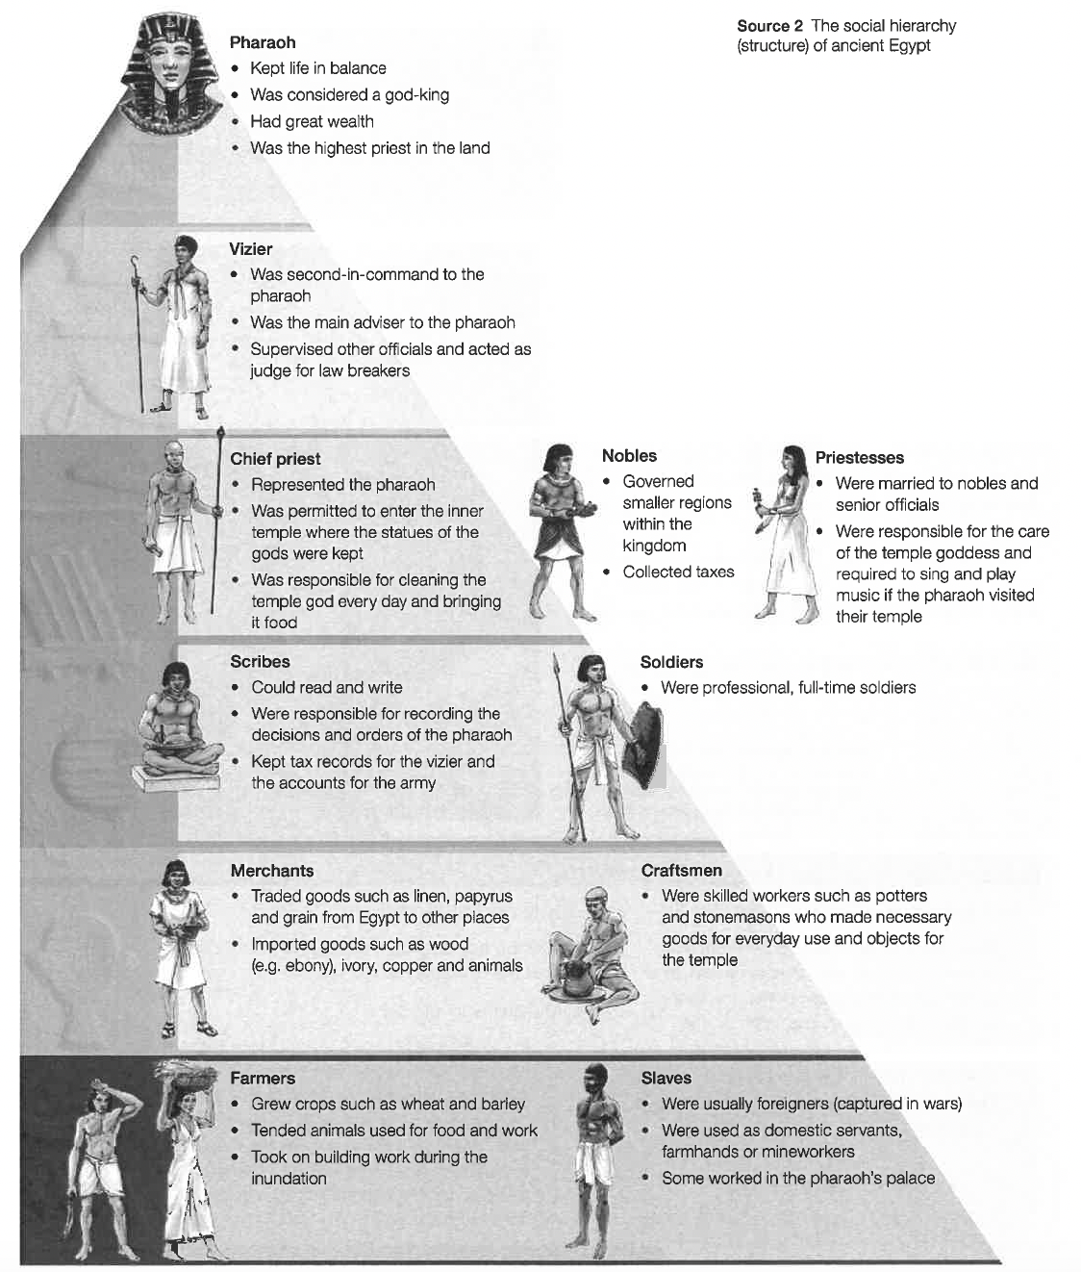
Use p. 227 of the Year 7 Oxford Humanities and Social Sciences book to label the social hierarchy on your page.
For each group in society, you might want to draw a symbol to represent them e.g. for a priest you may put the cross symbol, or for a scribe draw a pencil.
Then use it to fill in the table.

Slide 7
Questions
Now read p. 232 – 233 of the Oxford Year 7 Textbook and answer the following questions (using full sentences) in your HASS book:
How might a farmer’s social role change if he learnt to read and write?
Outline the type of lives that most slaves in ancient Egypt could expect to live. What types of duties were they expected to carry out?
List three important responsibilities that scribes would have had in ancient Egyptian society. Why has their work been so important to our understanding of ancient Egypt today?
State which group you would prefer to be in. Explain why you have chosen this group.

